Slide 1
BIT: IS AUDIT
Stanley Munga
sngigi@kyu.ac.ke

Slide 2
Topics
Defining IT Audit
Risk Analysis
Internal Controls
Steps of an IT Audit
Preparing to be Audited
Auditing IT Applications
Who is an auditor

Slide 3
THE IT ENVIRONMENT
There has always been a need for an effective internal control system.
The design and oversight of that system has typically been the responsibility of accountants.
The I.T. Environment complicates the paper systems of the past.
Concentration of data
Expanded access and linkages
Increase in malicious activities in systems vs. paper
Opportunity that can cause management fraud (i.e., override)

Slide 4
IT Investigative and Forensic Techniques for Auditors
Purpose
To assist auditors in developing the knowledge, skills, and abilities to provide reasonable assurance for the security, availability, integrity and management of information systems and resources.

Slide 5
The IT Audit
An IT audit is the process of collecting and evaluating evidence of an organization's information systems, practices, and operations. The evaluation of obtained evidence determines if the information systems are safeguarding assets, maintaining data integrity, and operating effectively and efficiently to achieve the organization's goals or objectives.

Slide 6
The IT Audit
These reviews may be performed in conjunction with a financial statement audit, an internal audit, or other form of attestation engagement.
External auditors can accept the result of an internal audit only if the function reports to the audit committee.
External auditors may use and rely upon a 3rd party IT audit firm.

Slide 7
What is IT Audit (informal)
Say what you do(document)
Do what you say( implement)
Evidence ( M&E)

Slide 8
Definition
IT/IS Audit
Independent assessment of an organization’s internal policies, controls, and activities. You use an audit to assess the presence and effectiveness of IT controls and to ensure that those controls are compliant with stated policies. In addition, audits provide reasonable assurance that organizations are compliant with applicable regulations and other industry requirements.
Address the risk exposures within IT systems and assess the controls and integrity of information systems
Notes:
This is an audit of how the confidentiatlity, integrity and availablility of an organizations information assets is assured. The point of doing it is to catch problems before an incident occurs and exposes the problem to the world at large. However a pen test is a very narrowly focused attempt to look for security holes in a critical resource, such as a firewall or webserver. With little or no information on your intended target.
On the other hand and IT Audit is broader range assessment. For example when pen testing a web server you are looking for vulnerabilities in the service and/or underlying system. An IT Security audit you want to know, who has access to this machine, who is allowed to make changes, are there any change logs being kept, how accurate, etc. There is also a full disclosure of the information.

Slide 9
Audit Charter
Audit charter (or engagement letter)
Stating management’s responsibility and objectives for, and delegation of authority to, the IT audit function
Outlining the overall authority, scope and responsibilities of the audit function

Slide 10
Scope of IT Audit
The scope of an IT audit often varies, but can involve any combination of the following:
Organizational— Examines the management control over IT and related programs, policies, and processes
Compliance— Pertains to ensuring that specific guidelines, laws, or requirements have been met
Application— Involves the applications that are strategic to the organization, for example those typically used by finance and operations
Technical— Examines the IT infrastructure and data communications

Slide 11
Questions to be asked
Are passwords difficult to crack?
Are there access control lists (ACLs) in place on network devices to control who has access to shared data?
Are there audit logs to record who accesses data?
Are the audit logs reviewed?
Are the security settings for operating systems in accordance with accepted industry security practices?
Have all unnecessary applications and computer services been eliminated for each system?
Are these operating systems and commercial applications patched to current levels?
How is backup media stored? Who has access to it? Is it up-to-date?
Is there a disaster recovery plan? Have the participants and stakeholders ever rehearsed the disaster recovery plan?
Are there adequate cryptographic tools in place to govern data encryption, and have these tools been properly configured?
Have custom-built applications been written with security in mind?
How have these custom applications been tested for security flaws?
How are configuration and code changes documented at every level? How are these records reviewed and who conducts the review?

Slide 12
IT/IS Audit Program goals
• Provide an objective and independent review of an organization’s policies, information systems, and controls.
• Provide reasonable assurance that appropriate and effective IT controls are in place.
• Provide audit recommendations for both corrective actions and improvement to controls.

Slide 13
Risk Analysis
Where is the risk? ….identify vulnerabilities
How significant is the risk? Likelihood and impact

Slide 14
Risk analysis (cont.)
Threat profile – what threats or risks will affect the asset?
Threat probability – what is the likelihood of the threats happening?
Threat consequence – what impact or effect would the loss of the asset have on the operation of the organization or its personnel
Threats+Impact+Likelihood = Risk

Slide 15
Threat’s list (examples)
Computer and network passwords. Is there a log of all people with passwords (and what type). How secure is this ACL list, and how strong are the passwords currently in use?
Physical assets. Can computers or laptops be picked up and removed from the premises by visitors or even employees?
Data backups. What backups of virtual assets exist, how are they backed up, where are the backups kept, and who conducts the backups?
Logging of data access. Each time someone accesses some data, is this logged, along with who, what, when, where, etc.?
Access to sensitive customer data, e.g., credit card info. Who has access? How can access be controlled? Can this information be accessed from outside the company premises?
Access to client lists. Does the website allow backdoor access into the client database? Can it be hacked?
Long-distance calling. Are long-distance calls restricted, or is it a free-for-all? Should it be restricted?
Emails. Are spam filters in place? Do employees need to be educated on how to spot potential spam and phishing emails? Is there a company policy that outgoing emails to clients not have certain types of hyperlinks in them?

Slide 16
Risk Analysis (cont.)
From the IT auditor’s perspective, risk analysis serves more than one purpose:
It assists the IT auditor in identifying risks and threats to an IT environment and IT system—risks and threats that would need to be addressed by management—and in identifying system specific internal controls. Depending on the level of risk, this assists the IT auditor in selecting certain areas to examine.

Slide 17
Risk Analysis (cont.)
It helps the IT auditor in his/her evaluation of controls in audit planning.
It assists the IT auditor in determining audit objectives.
It supports risk-based audit decision making.
Part of audit planning
Helps identify risks and vulnerabilities
The IT auditor can determine the controls needed to mitigate those risks

Slide 18
Risk Analysis (cont.)
IT auditors must be able to:
Be able to identify and differentiate risk types and the controls used to mitigate these risks
Have knowledge of common business risks, related technology risks and relevant controls
Be able to evaluate the risk assessment and management techniques used by business managers, and to make assessments of risk to help focus and plan audit work
Have an understand that risk exists within the audit process
Notes:
In evaluating IT-related business processes applied by an organization, understanding the relationship between risk and control is important for IT audit and control professionals.

Slide 19
Risk Analysis (cont.)
In analyzing the business risks arising from the use of IT, it is important for the IT auditor to have a clear understanding of:
The purpose and nature of business, the environment in which the business operates and related business risks
The dependence on technology and related dependencies that process and deliver business information
The business risks of using IT and related dependencies and how they impact the achievement of the business goals and objectives
A good overview of the business processes and the impact of IT and related risks on the business process objectives

Slide 20
Risk Analysis (cont.)
Notes:
The risk assessment process is characterized as an iterative life cycle which begins with identifying business objectives, information assets, and the underlying systems or information resources that generate/store, use or manipulate the assets (hardware, software, databases, networks, facilities, people, etc.) critical to achieving these objectives.
Next, during the risk mitigation phase, controls are identified for mitigating identified risks. These controls are risk-mitigating countermeasures that should prevent or reduce the likelihood of a risk event occurring, detect the occurrence of a risk event, minimize the impact, or transfer the risk to another organization.
The assessment of countermeasures should be performed through a cost-benefit analysis where controls to mitigate risks are selected to reduce risks to a level acceptable to management. This analysis process may be based on any of the following:
• The cost of the control compared to the benefit of minimizing the risk
• Management’s appetite for risk (i.e., the level of residual risk that management is prepared to accept)
• Preferred risk-reduction methods (e.g., terminate the risk, minimize probability of occurrence, minimize impact, transfer the risk via insurance)
The final phase relates to monitoring performance levels of the risks being managed when identifying any significant changes in the environment that would trigger a risk reassessment, warranting changes to its control environment. It encompasses three processes—risk assessment, risk mitigation and risk reevaluation—in determining whether risks are being mitigated to a level acceptable to management.

Slide 21
Internal Controls
These are the Policies, procedures, practices and organizational
structures implemented to reduce risks
Classification of internal controls
Preventive controls
Detective controls
Corrective controls

Slide 22
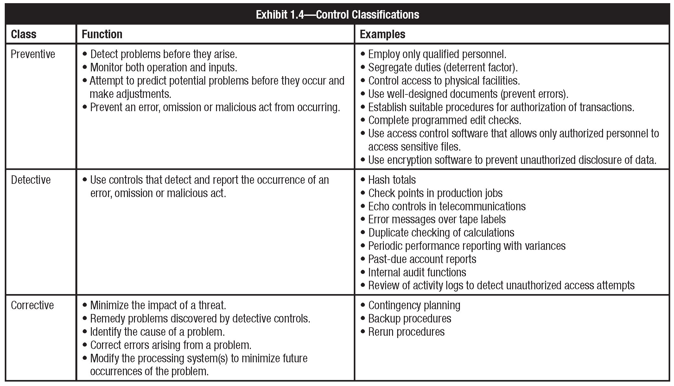
Internal Controls (continued)

Slide 23
Internal Control Objectives
Internal control objectives
Safeguarding of IT assets
Compliance to corporate policies or legal requirements
Input
Authorization
Accuracy and completeness of processing of data input/transactions
Output
Reliability of process
Backup/recovery
Efficiency and economy of operations
Change management process for IT and related systems
Notes:
Internal control objectives are statements of the desired result or purpose to be achieved by implementing control activities (procedures).

Slide 24
Steps of An IT Audit
1. Planning Phase
2. Testing Phase
3. Reporting Phase
Ideally it’s a continuous cycle
Again not always the case

Slide 25
Planning Phase
Defining the Scope of Your Audit
Security Parameter
The security perimeter is both a conceptual and physical boundary within which your security audit will focus, and outside of which your audit will ignore.

Slide 26
Example Asset list
Computers and laptops
Routers and networking equipment
Printers
Cameras, digital or analog, with company-sensitive photographs
Data - sales, customer information, employee information
Company smartphones/ PDAs
VoIP phones, IP PBXs (digital version of phone exchange boxes), related servers
VoIP or regular phone call recordings and records
Email
Log of employees daily schedule and activities
Web pages, especially those that ask for customer details and those that are backed by web scripts that query a database
Web server computer
Security cameras
Employee access cards.
Access points (i.e., any scanners that control room entry)

Slide 27
Planning Phase Outcome
Entry Meeting
Define Scope
Learn Controls
Historical Incidents
Past Audits
Site Survey
Review Current Policies
Questionnaires
Define Objectives
Develop Audit Plan / Checklist
Notes:
Controls are management controls, authentication/access controls, physical security, outsider access to systems, system administration controls and procedures, connections to external networks, remote access, incident response, contingency plan.

Slide 28
Some regulations to keep in mind
OTS (Department of Treasury - Office of Thrift Savings) - Banking Regulations
SEC (Securities and Exchange Commission) - Mutual Funds
HIPPA - Health Care
Sarbanes Oxley - Financial Reports, Document Retention
FERPA (Family Education Rights and Privacy Act) - Student Records

Slide 29
Testing Phase
Meet With Site Managers
What data will be collected
How/when will it be collected
Site employee involvement
Get questions answered

Slide 30
Testing Phase (cont.)
Data Collection
Based on scope/objectives
Types of Data
Physical security
Interview staff
Vulnerability assessments
Access Control assessments

Slide 31
Procedures for Testing and Evaluating IT Controls
Use of generalized audit software to survey the contents of data files
Use of specialized software to assess the contents of operating system parameter files
Flow-charting techniques for documenting automated applications and business process
Use of audit reports available in operation systems
Documentation review
Observation

Slide 32
Testing Assets (example)
Computer and network passwords. Is there a log of all people with passwords (and what type). How secure is this ACL list, and how strong are the passwords currently in use?
Physical assets. Can computers or laptops be picked up and removed from the premises by visitors or even employees?
Records of physical assets. Do they exist? Are they backed up?o
Data backups. What backups of virtual assets exist, how are they backed up, where are the backups kept (onsite and/or offsite), and who conducts the backups?
Logging of data access. Each time someone accesses some data, is this logged, along with who, what, when, where, etc.?
Access to sensitive customer data, e.g., credit card info. Who has access? How can access be controlled? Can this information be accessed from outside the company premises?
Access to client lists. Does the website allow backdoor access into the client database? Can it be hacked?
Long-distance calling. Are long-distance calls restricted, or is it a free-for-all? Should it be restricted?
Emails. Are spam filters in place? Do employees need to be educated on how to spot potential spam and phishing emails? Is there a company policy that outgoing emails to clients not have certain types of hyperlinks in them?
Past Due Diligence & Predicting the Future: Checking past security threat trends and predicting future ones

Slide 33
Reporting Phase
Exit Meeting - Short Report
Immediate problems
Questions & answer for site managers
Preliminary findings
IS auditors should be aware that, ultimately, they are responsible to senior management and the audit committee of the board of directors. IS auditors should feel free to communicate issues or concerns to such management.

Slide 34
Reporting Phase (cont.)
Long Report After Going Through Data
Intro defining objectives/scope
How data was collected
Summary of problems
Table format
Historical data (if available)
Ratings
Fixes
Page # where in depth description is

Slide 35
Reporting Phase (cont.)
In depth description of problem
How problem was discovered
Fix (In detail)
Industry standards (if available)
Glossary of terms
References
Note: The Above Varies Depending on Where You Work

Slide 36
Reporting Phase (cont.)
Audit report structure and contents
An introduction to the report
Audit findings presented in separate sections
The IS auditor’s overall conclusion and opinion
The IS auditor’s reservations with respect to the audit
Detailed audit findings and recommendations
Materiality of findings
Notes:
The IS auditor must use judgment when deciding which findings to present to various levels of management. For example, the IS auditor may find that the transmittal form for delivering tapes to the offsite storage location is not properly initialed or authorization evidenced by management as required by procedures. If the IS auditor finds that management otherwise pays attention to this process and that there have been no problems in this area, the IS auditor may decide that the failure to initial transmittal documents is not material enough to bring to the attention of upper management. The IS auditor might decide to discuss this only with local operations management. However, there may be other control problems that will cause the IS auditor to conclude that this is a material error, because it may lead to a larger control problem in other areas. The IS auditor should always judge which findings are material to various levels of management and should report them accordingly.

Slide 37
Audit Documentation
Audit documentation includes:
Planning and preparation of the audit scope and objectives
Description on the scoped audit area
Audit program
Audit steps performed and evidence gathered
Other experts used
Audit findings, conclusions and recommendations
Notes:
It is also recommended that documentation include:
• A copy of the report issued as a result of the audit work
• Evidence of audit supervisory review

Slide 38
Example Audit checklist
“An Auditor’s Checklist for Performing a Perimeter Audit of on IBM ISERIES (AS/400) System” - Craig Reise
Scope of the audit does not include the Operating System
Physical security
Services running
Notes:
Example of defining objectives and scope

Slide 39
Implementation of Recommendations
Auditing is an ongoing process
Timing of follow-up
Notes:
IS auditors should realize that auditing is an ongoing process. The IS auditor is not effective if audits are performed and reports issued, but no follow-up is conducted to determine if management has taken appropriate corrective actions. IS auditors should have a follow-up program to determine if agreed-to corrective actions have been implemented. Although IS auditors who work for external audit firms may not necessarily follow this process, they may achieve these tasks if agreed to by the audited entity.

Slide 40
Summary of IT Audit Process: 8 Steps
Plan the audit
Hold kickoff meeting
Gather data/test IT controls
Remediate identified deficiencies (organization)
Test remediated controls
Analyze and report findings
Respond to findings (organization)
Issue final report (auditor)

Slide 41
Preparing To Be Audited
This Is NOT a Confrontation
Make Your Self Available
Know What The Scope/Objectives Are
Know What Type of Data Will be Collected
Know What Data Shouldn’t be Collected
Notes:
Generally specific records shouldn’t be needed instead an agregaion

Slide 42
Application Audit
An assessment Whose Scope Focuses on a Narrow but Business Critical Processes or Application
Excel spreadsheet with embedded macros used to analyze data
Payroll process that may span across several different servers, databases, operating systems, applications, etc.
The level of controls is dependent on the degree of risk involved in the incorrect or unauthorized processing of data

Slide 43
Application Audit (cont.)
1. Administration
2. Inputs, Processing, Outputs
3. Logical Security
4. Disaster Recovery Plan
5. Change Management
6. User Support
7. Third Party Services
8 . General Controls
Notes:
An Application Audit, should, at a minimum determine the existence of controls in these areas
1 to 7 are more important
While 8 is a bit outside of the scope

Slide 44
Application Audit - Administration
Probably the most important area of the audit, because this area focuses on the overall ownership and accountability of the application
Roles & Responsibilities - development, change approval, access authorization
Legal or regulatory compliance issues
Notes:
Roles & Responsibilities should be segregated. What compliance do you need to follow

Slide 45
Application Audit - Inputs, Processing, Outputs
Looking for evidence of data preparation procedures, reconciliation processes, handling requirements, etc.
Run test transactions against the application
Includes who can enter input and see output
Retention of output and its destruction

Slide 46
Application Audit - Logical Security
Looking at user creation and authorization as governed by the application its self
User ID linked to a real person
Number of allowable unsuccessful log-on attempts
Minimum password length
Password expiration
Password Re-use ability
SQL injection
XSS attacks

Slide 47
Application Audit - Disaster Recovery Plan
Looking for an adequate and performable disaster recovery plan that will allow the application to be recovered in a reasonable amount of time after a disaster
Backup guidelines, process documentation, offsite storage guidelines, SLA’s (Service Level agreements) with offsite storage vendors, etc.
Notes:
Service level agreement

Slide 48
Application Audit - Change Management
Examines the process changes to an application go through
Process is documented, adequate and followed
Who is allowed to make a request a change, approve a change and make the change
Change is tested and doesn’t break compliance (determined in Administration) before being placed in to production
Notes:
When testing change management, the IS auditor should always start with system-generated information, containing the date and time a module was last updated, and trace from there to the documentation authorizing the change. To trace in the opposite direction would run the risk of not detecting undocumented changes. Similarly, focusing exclusively on the accuracy or completeness of the documentation examined does not ensure that all changes were in fact documented.

Slide 49
Application Audit - User Support
One of the most overlooked aspects of an application
User documentation (manuals, online help, etc.) - available & up to date
User training - productivity, proper use, security
Process for user improvement requests

Slide 50
Application Audit - Third Party Services
Look at the controls around any 3rd party services that are required to meet business objectives for the application or system
Liaison to 3rd party vendor
Review contract agreement
SAS (Statement on Auditing Standards) N0. 70 - Service organizations disclose their control activities and processes to their customers and their customers’ auditors in a uniform reporting format

Slide 51
Application Audit - General Controls
Examining the environment the application exists within that affect the application
System administration / operations
Organizational logical security
Physical security
Organizational disaster recovery plans
Organizational change control process
License control processes
Virus control procedures
Notes:
Application doesn’t exist within a bubble. Not doing in depth audit on these points

Slide 52
Internal Auditing Standards
According to the Institute of Internal Auditors (IIA), the purpose of an internal audit is to evaluate the adequacy and effectiveness of a company’s internal control system.
Also, it is to determine the extent to which assigned responsibilities are actually carried out.

Slide 53
AUDITING Standards: The five components of internal control are:
The control environment
Risk assessment
Information & communication
Monitoring
Control activities
Notes:
Control Environment. According to the COSO Report, the control environment “sets the tone of an organization and influences the control consciousness of its people.” It provides structure and discipline, and forms the foundation for all other components of internal control.
Risk Assessment. Risk assessment refers to the “identification, analysis, and management of risks relevant to the preparation of financial statements that are fairly presented in conformity with generally accepted accounting principles [GAAP] (or another comprehensive basis of accounting).”
Control Activities. Control activities are the policies and procedures that help ensure that management’s directives are carried out.
Information and Communication. The identification, capture and exchange of information in a form and timeframe that enables people to carry out their responsibilities.
Monitoring. In relation to the COSO report and SAS 78, monitoring refers to the process used to assess the quality of internal control performance over time.
Adequate internal control is a key defense (but no guarantee) against fraud, errors and program abuse.

Slide 54
SAS 78
The Auditing Standards Board of the American Institute of Certified Public Accountants (AICPA) incorporated the components of internal control presented in the COSO Report in its Statement on Auditing Standards No. 78 (SAS 78), entitled “Consideration of Internal Control in a Financial Statement Audit.”

Slide 55
SAS 78 (#1:Control Environment -- elements)
Describe how each one could adversely affect internal control.
The integrity and ethical values
Structure of the organization
Participation of audit committee
Management’s philosophy and style
Procedures for delegating
Notes:
Page 13

Slide 56
SAS 78 (#1:Control Environment -- elements)
Management’s methods of assessing performance
External influences
Organization’s policies and practices for managing human resources

Slide 57
SAS 78 (#1:Control Environment -- techniques)
Describe possible activity or tool for each.
Assess the integrity of organization’s management
Conditions conducive to management fraud
Understand client’s business and industry
Determine if board and audit committee are actively involved
Study organization structure

Slide 58
SAS 78 (#2:Risk Assessment)
Changes in environment
Changes in personnel
Changes in I.S.
New IT’s
Significant or rapid growth
New products or services (experience)
Organizational restructuring
Foreign markets
New accounting principles

Slide 59
SAS 78 (#3:Information & Communication-elements)
Initiate, identify, analyze, classify and record economic transactions and events.
Identify and record all valid economic transactions
Provide timely, detailed information
Accurately measure financial values
Accurately record transactions

Slide 60
SAS 78 (#3:Information & Communication-techniques)
Auditors obtain sufficient knowledge of I.S.’s to understand:
Classes of transactions that are material
Accounting records and accounts used
Processing steps:initiation to inclusion in financial statements (illustrate)
Financial reporting process (including disclosures)

Slide 61
SAS 78 (#4: Monitoring)
By separate procedures (e.g., tests of controls)
By ongoing activities (Embedded Audit Modules – EAMs and Continuous Online Auditing - COA)

Slide 62
SAS 94 The Effect of Information Technology on the Auditor’s Consideration of Internal Control in a Financial Statement Audit
Provides auditors with guidance on IT’s effect on internal control and on the auditor’s understanding of internal control and the assessment of control risk.
Requires the auditor to consider how an organization’s IT use affects his or her audit strategy.
Where a significant amount of information is electronic, the auditor may decide it is not practical or possible to limit detection risk to an acceptable level by performing only substantive tests for one or more financial statement assertions. In such cases, the auditor should gather evidence about the effectiveness of both the design and operation of controls intended to reduce the assessed level of control risk.
Notes:
SAS No. 94 and Tests of Controls
Under the auditing standards (SAS Nos. 48, 55 and 78) relevant to computer-based systems issued prior to SAS No. 94, a large percentage of auditors assessed control risk at the maximum and performed only substantive tests of account balances and classes of transactions to gather evidence about financial statement assertions. SAS No. 94 recognizes that this approach may not be viable in complex IT environments. When evidence of a firm's initiation, recording and processing of transactions exists only in electronic form, the auditor's ability to obtain the desired assurance only from substantive tests is significantly diminished. SAS No. 94 does not change the requirement to perform substantive tests on significant amounts, but states that "it is not practical or possible to restrict detection risk to an acceptable level by performing only substantive tests."3 When assessing the effectiveness of the design and operation of controls in complex IT environments, it is necessary for the auditor to test these controls. The decision to test controls is not related to the size of the firm but to the complexity of the IT environment.

Slide 63
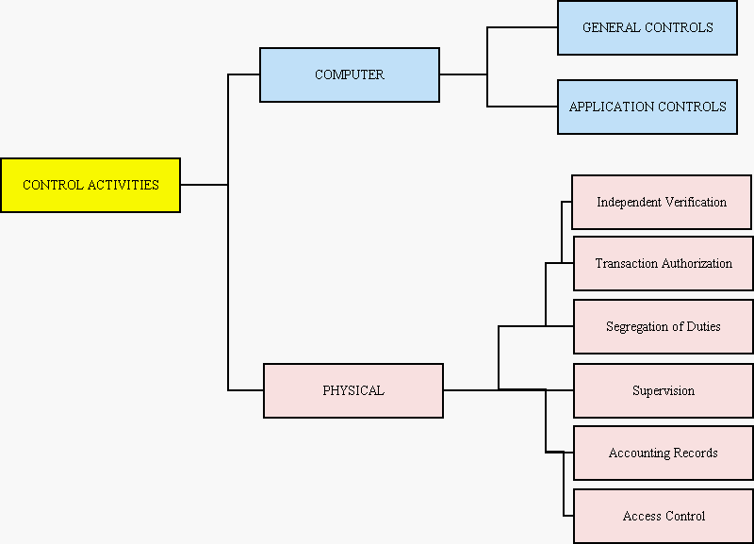
SAS 78 (#5: Control Activities)

Slide 64
Physical Controls (1-3)
Transaction authorization
Example:
Sales only to authorized customer
Sales only if available credit limit
Segregation of duties
Examples of incompatible duties:
Authorization vs. processing [e.g., Sales vs. Auth. Cust.]
Custody vs. recordkeeping [e.g., custody of inventory vs. DP of inventory]
Fraud requires collusion [e.g., separate various steps in process]
Supervision
Serves as compensating control when lack of segregation of duties exists by necessity

Slide 65
Physical Controls (4-6)
Accounting records (audit trails; examples)
Access controls
Direct (the assets)
Indirect (documents that control the assets)
Fraud
Disaster Recovery
Independent verification
Management can assess:
The performance of individuals
The integrity of the AIS
The integrity of the data in the records
Examples

Slide 66
References
www.isaca.org
“An Auditor’s Checklist for Performing a Perimeter Audit of on IBM ISERIES (AS/400) System” - Craig Reise
“Conducting a Security Audit: An Introductory Overview” - Bill Hayes
“The Application Audit Process - A Guide for Information Security Professionals” - Robert Hein

